Slide 2
Intended Progress
Full Playability
Random World Generation
Character/AI movement
Base Combat Mechanics
Full asset creation ability
Basic Networking/Packet Structure
Game Logic Management
Questing
Random Object/Item Generation

Slide 3
Current Progress
World Generation
Combat graphical interface completed
Asset Creation - mostly done
Dialogue
Items/Equipment
Character/NPC
Player Movement
AI Movement
Created base components. No logic
Base Network Structure

Slide 4
Problems Encountered
Kyle went to another continent for 11 days
Few merge conflicts
Visual Studio project files
Linking libraries correctly
Minor code running issues.
Time estimates being overly ambitious

Slide 5
Issues Not Completed
Combat implementation
Dungeon/Cave Generation
Overworld Object Generation
Randomized Items/Equipment
Town Menu
Quest Menu
Spell Interface/Collection
Monster Creation

Slide 6
Future Goals
Sprint 5
Finish remainder of playability goals
Advanced Combat
Penetration
Blunt
Introduce Questing/Game Goals
Asset Sharing over Network
Sprint 6
Zeus Functionality
Player Control
Storyline Generation
World Interaction
Overworld & Combat music/sound bytes
Town Generation
Animation
VoIP

Slide 7
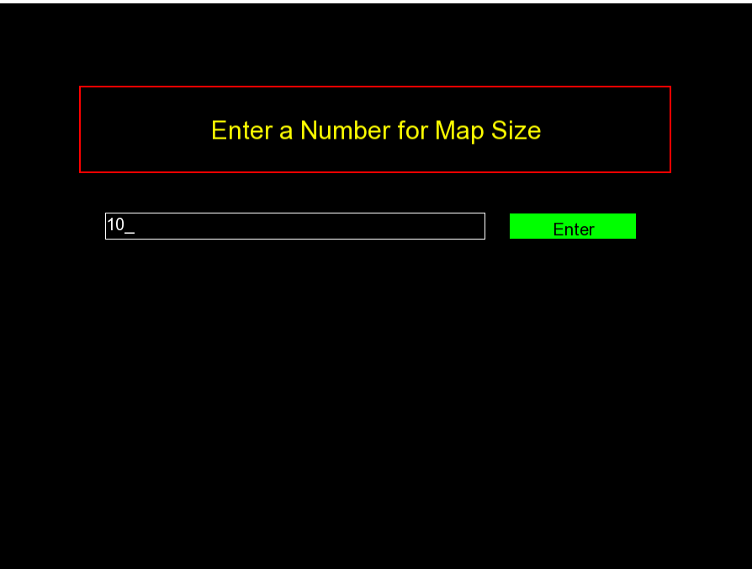

Slide 8
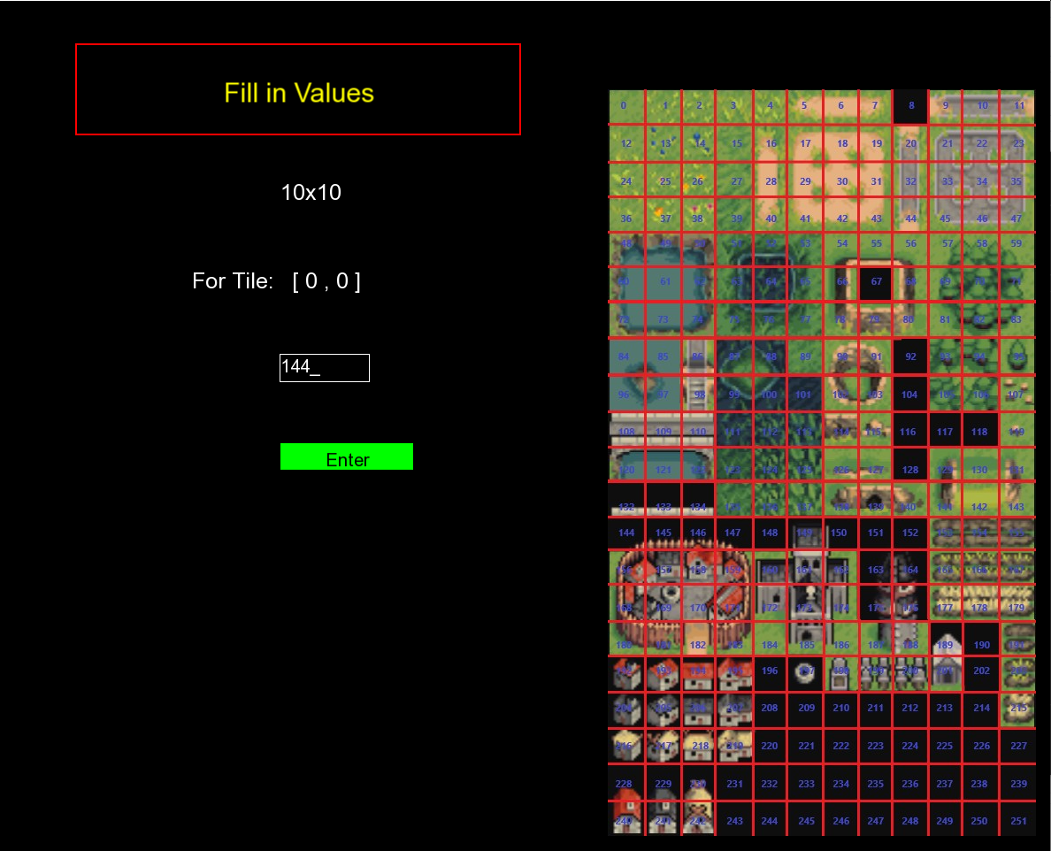

Slide 9
